Slide 1

Project Title – Seasonal Agriculture Performance Analysis
AICTE STU ID : STU691884604e8cc1763214432
Internship ID : INTERNSHIP_17830691666a4779eecfe8a
Student Name : Onkar Abhiman Londhe

Slide 2

PROBLEM STATEMENT
Agricultural performance varies across seasons due to changes in environmental conditions, farming practices, resource availability, irrigation and market conditions.
The raw agricultural dataset does not directly reveal:
  Which season provides better agricultural performance
  How crop yield changes across seasons
  How environmental conditions affect yield
  How irrigation and water usage differ
  How production and profitability vary
  Which regions or crops show unusual performance
Problem
To analyze agricultural data across Kharif, Rabi and Zaid seasons and identify meaningful patterns, relationships, variations and performance differences for better agricultural planning.

Slide 3
Project Description
This project applies Data Analytics and Visualization techniques to understand seasonal agricultural performance using the provided dataset.
Dataset :
  4,000 agricultural records
  28 variables
  3 seasons: Kharif, Rabi, Zaid
  8 states
  10 districts
  8 crop categories
Dataset Contains :
  Analysis Performed
  Data cleaning and preprocessing
  Exploratory Data Analysis
  Seasonal performance comparison
  Crop and district analysis
  Environmental condition analysis
  Irrigation and water-use analysis
  Cost, revenue, profit and ROI analysis
  Correlation and statistical analysis
  Outlier/anomaly analysis
  Geographic visualization using maps
Goal
Convert raw agricultural data into meaningful, evidence-based insights and recommendations for seasonal agricultural planning.

Slide 4

WHO ARE THE END USERS?
Primary End Users
🌾 Farmers
Select suitable crops and seasons
Understand yield patterns
Improve resource utilization
🏛️ Agricultural Departments
Support seasonal agricultural planning
Identify regional performance differences
Plan resource allocation
💧 Irrigation & Water Management Authorities
Analyze water requirements
Compare irrigation methods
Support efficient water management
📊 Agricultural Analysts & Researchers
Study seasonal trends
Analyze environmental relationships
Conduct agricultural research
💼 Agribusiness & Agri-Tech Companies
Understand crop and market performance
Support data-driven agricultural decisions
Develop agricultural decision-support solutions
🎓 Students & Academics
Perform agricultural data analysis
Develop research and analytical models

Slide 5

Technology Used
Technology | Purpose
Python | Core programming and analysis
Pandas | Data loading, cleaning, grouping and aggregation
NumPy | Numerical calculations and feature engineering
Matplotlib | Data visualization
Seaborn | Statistical visualization and correlation heatmap
Jupyter Notebook | Interactive development and documentation

Slide 6
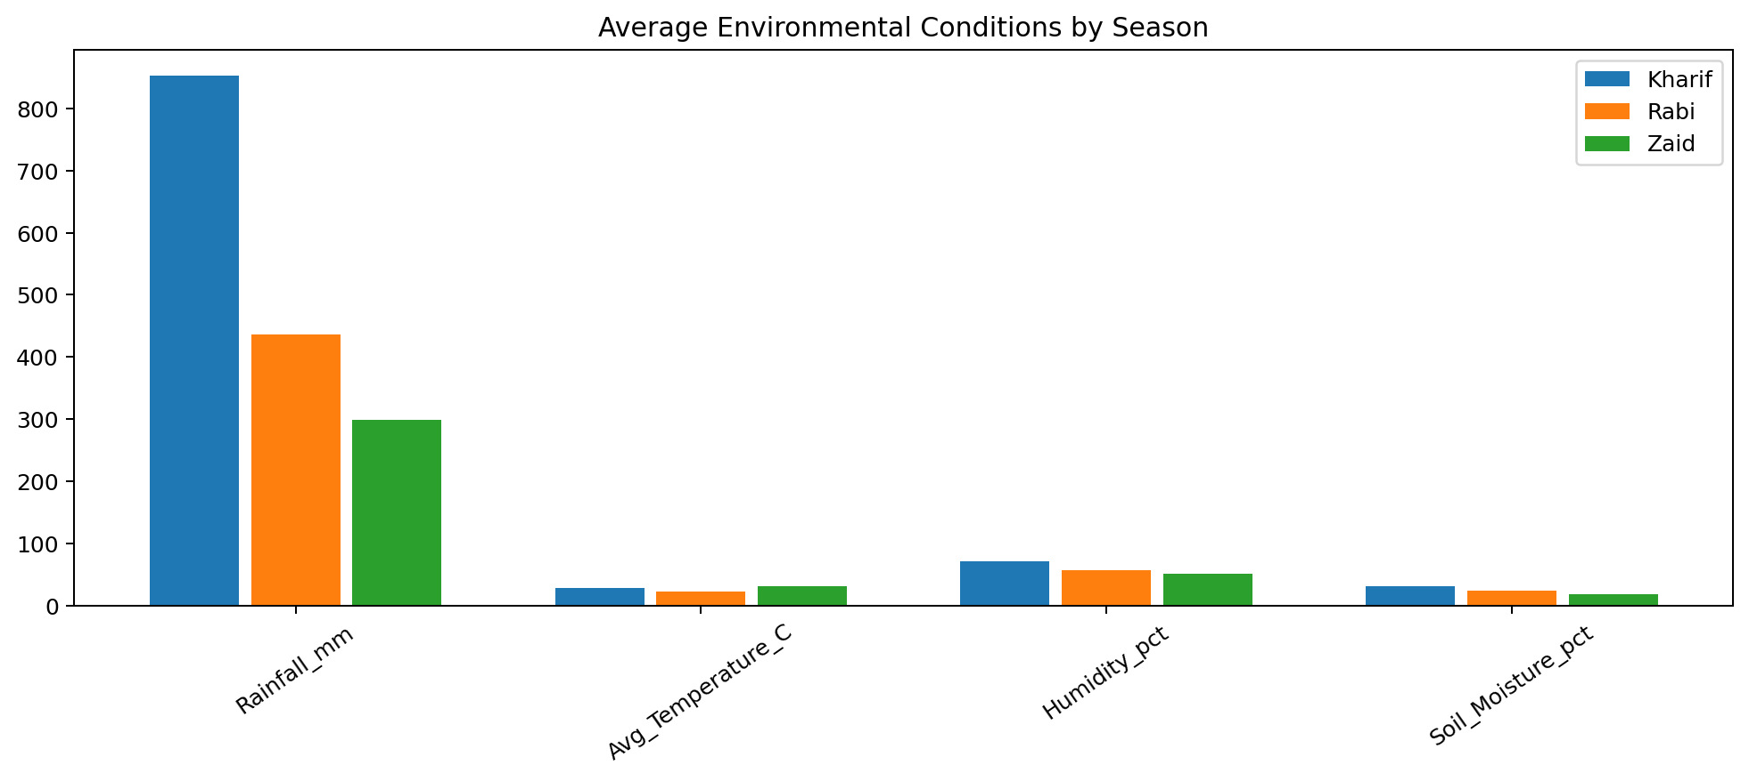
RESULTS
Github Link

Slide 7
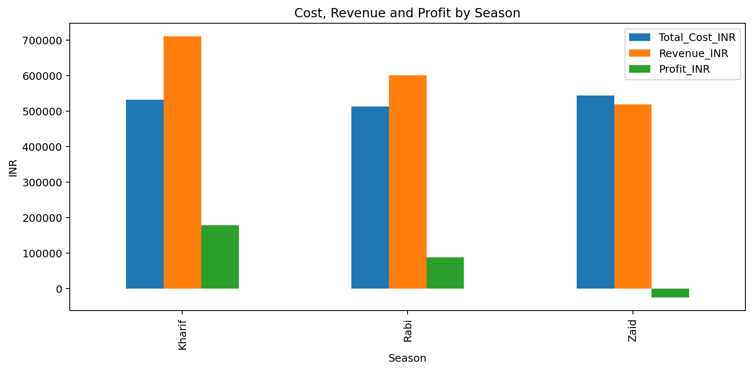
RESULTS
Github Link

Slide 8
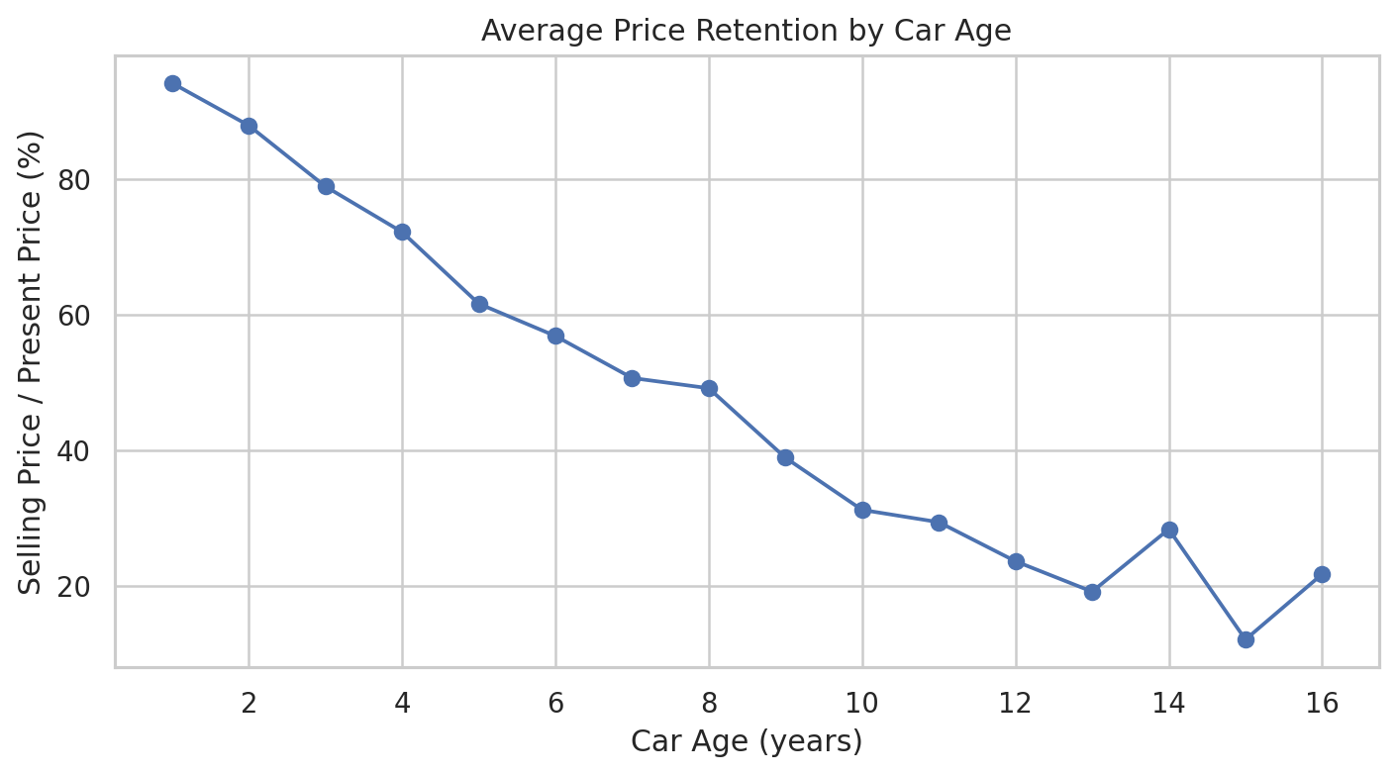
RESULTS
Github Link

Slide 9
Thank you
.

